Slide 1

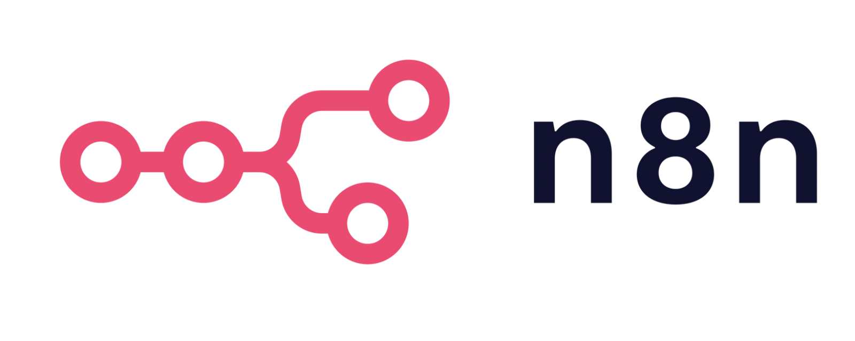
MCP Server and Client
Built with n8n and Firecrawl

Slide 2

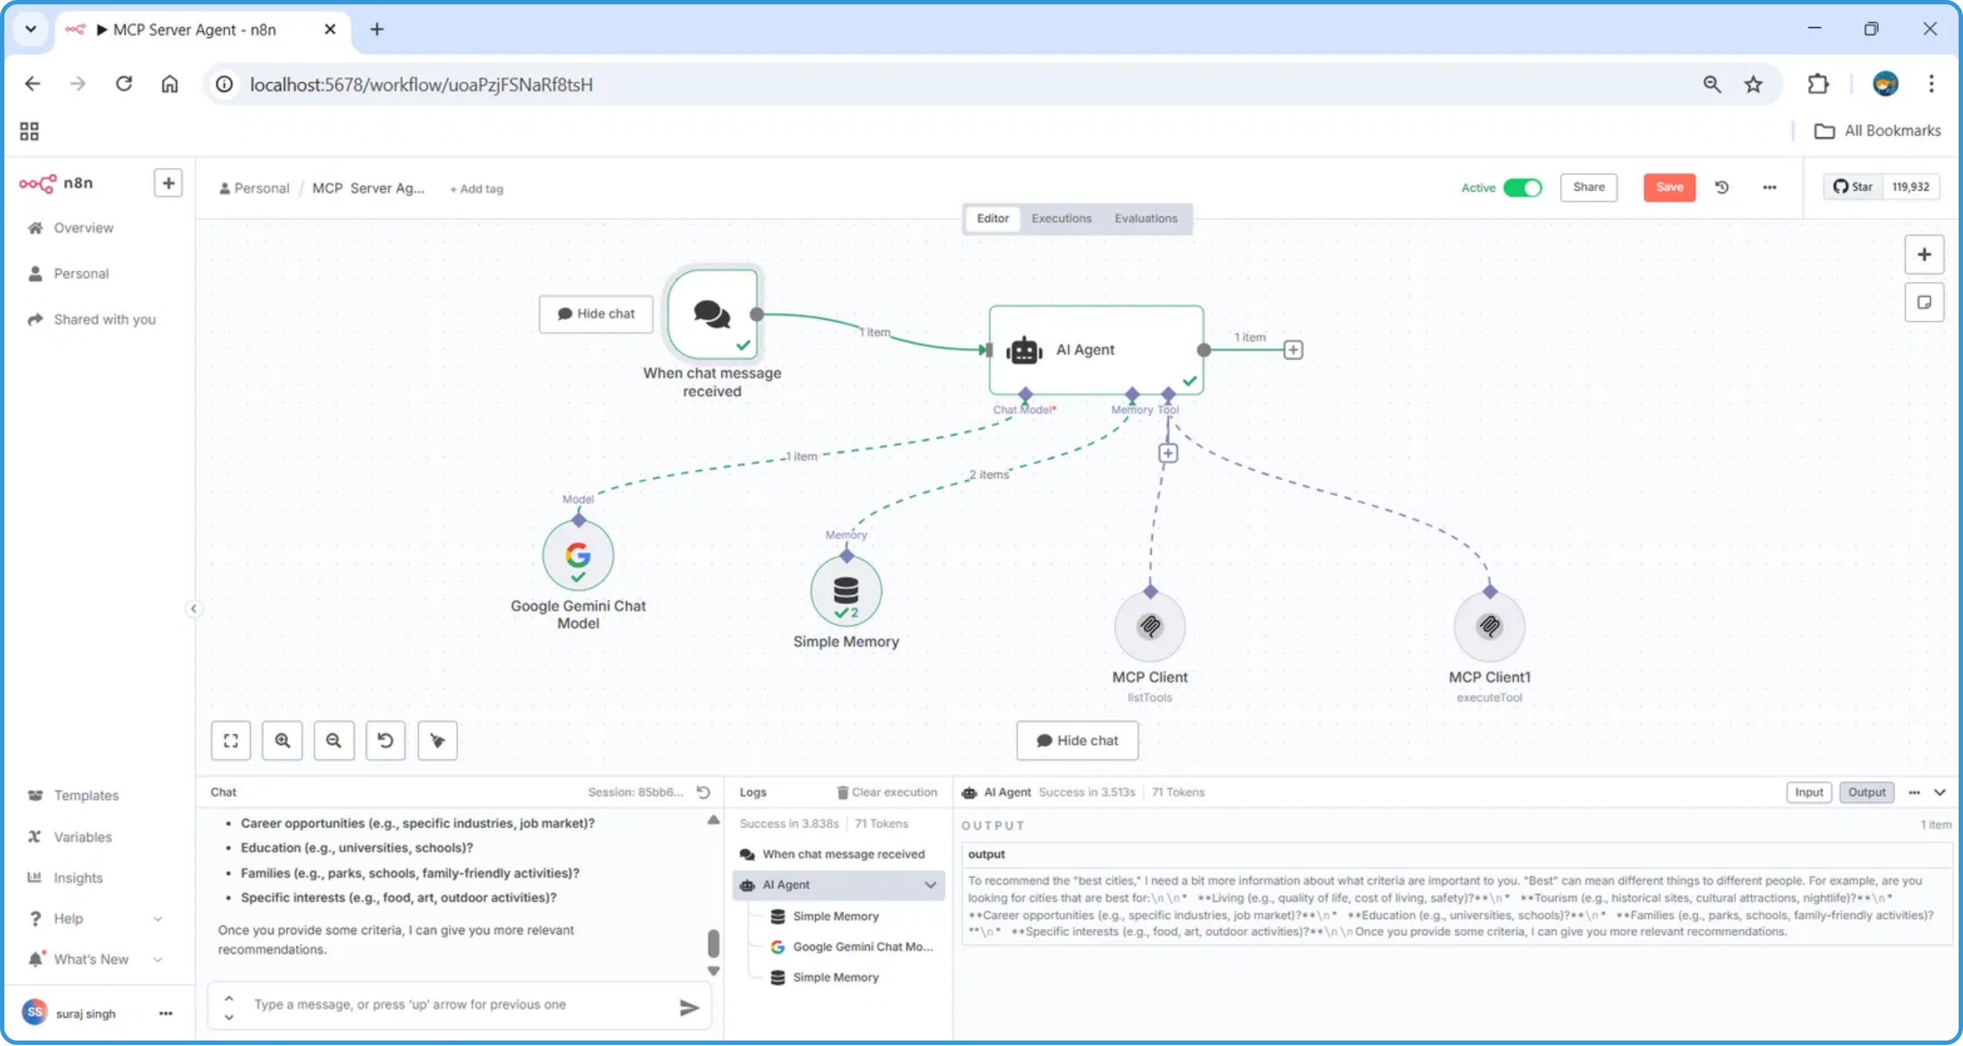






System Architecture
Core Components
Integration Components
Chat Trigger:
Initiates workflow when messages are
Google Gemini Chat Model:
AI model for generating
received
responses
AI Agent:
Central processing node for conversation
MCP Client:
Executes tools and actions based on AI
management
directives
Simple Memory:
Stores and retrieves conversation
Firecrawl:
Data extraction and processing for
context
enhanced AI responses

Slide 3



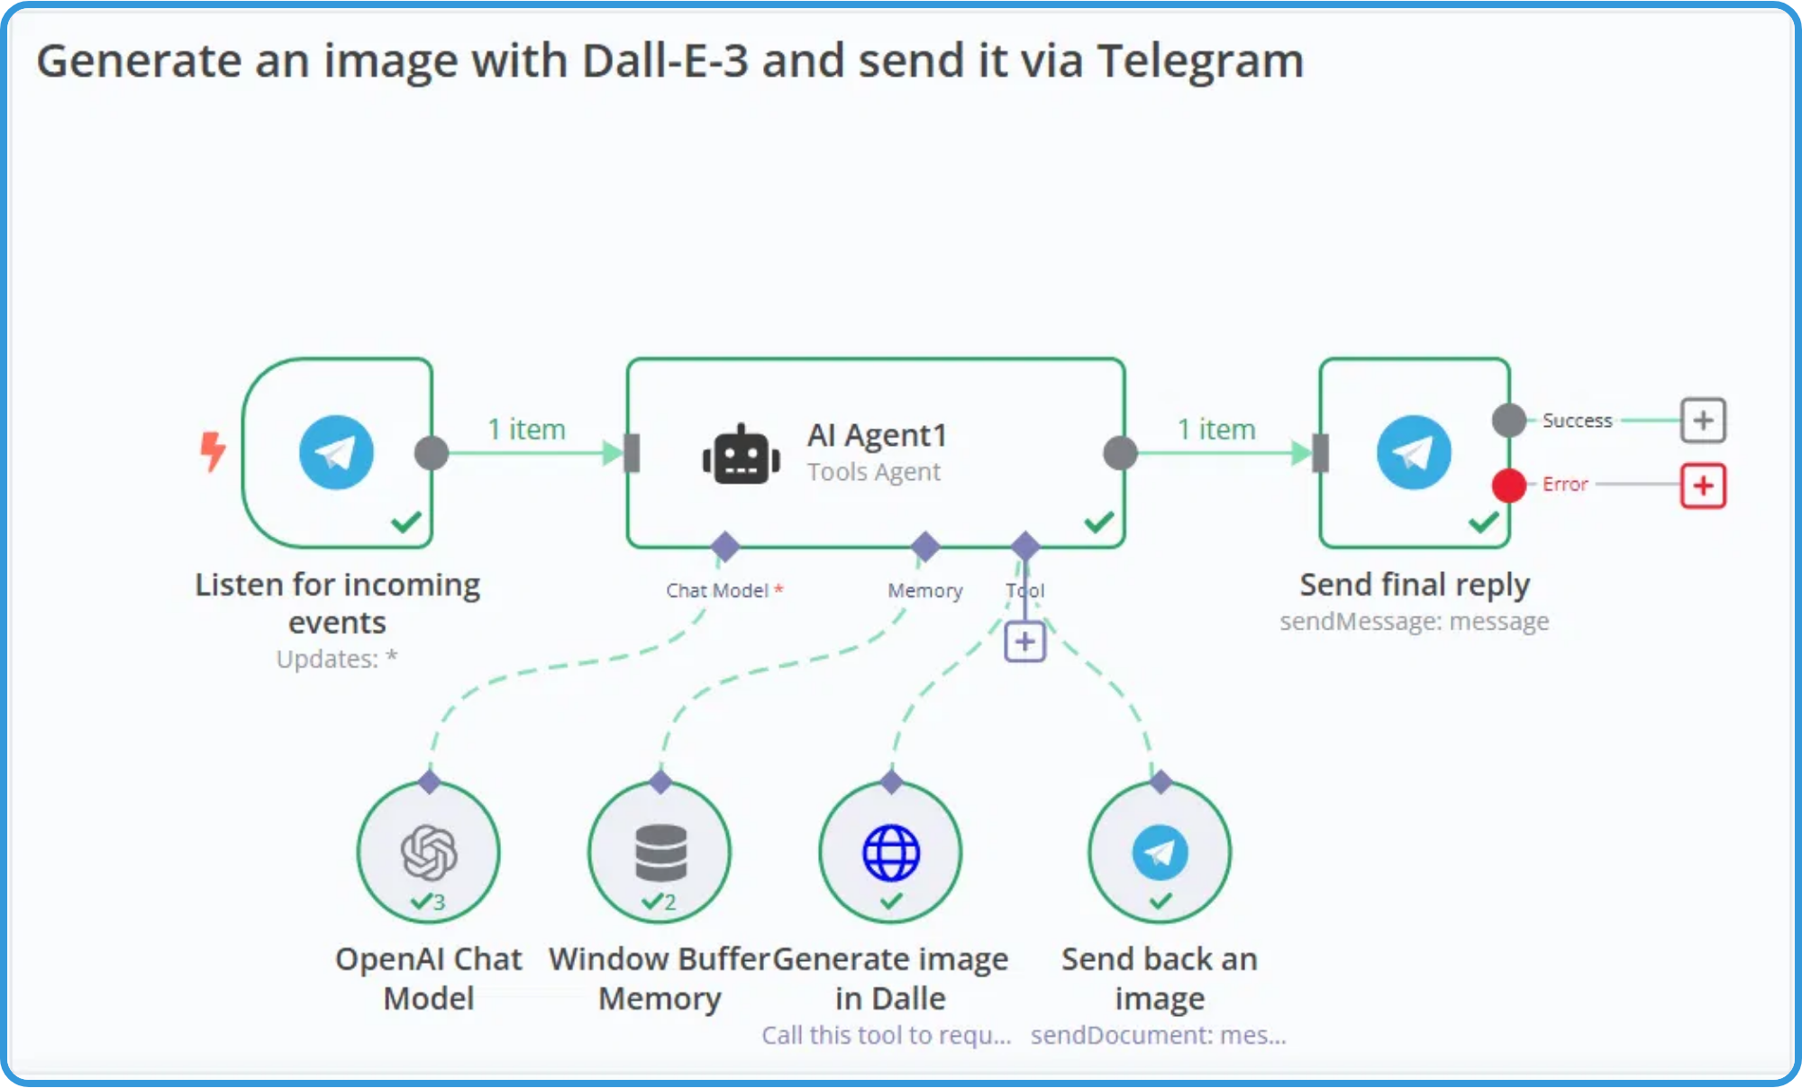


Prerequisites
n8n Installation
A running instance of n8n (self-hosted or cloud service)
No login required for this implementation
Google Gemini API
API key for Google Gemini Chat Model to enable AI capabilities
Firecrawl API (Optional)
API key for Firecrawl to enable data extraction and processing
Workflow JSON File
The n8n workflow file containing the MCP server and client configuration

Slide 4

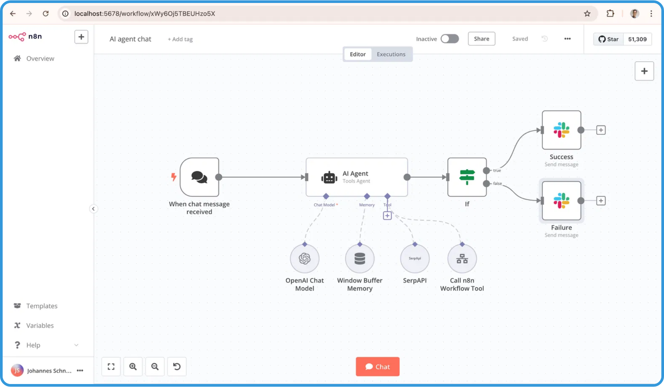
Installation and Setup
Install n8n
Install n8n locally or use the cloud service. For local installation:
npm install n8n -g
No login required for this implementation
Start n8n
Launch n8n with the following command:
n8n start
This will start n8n on localhost:5678 by default
Obtain API Keys
Get your Google Gemini API key from Google AI Studio
If using Firecrawl, obtain an API key from their developer portal
Prepare Workflow File
Download the MCP Server and Client workflow JSON file
Keep it accessible for the next step - importing into n8n

Slide 5
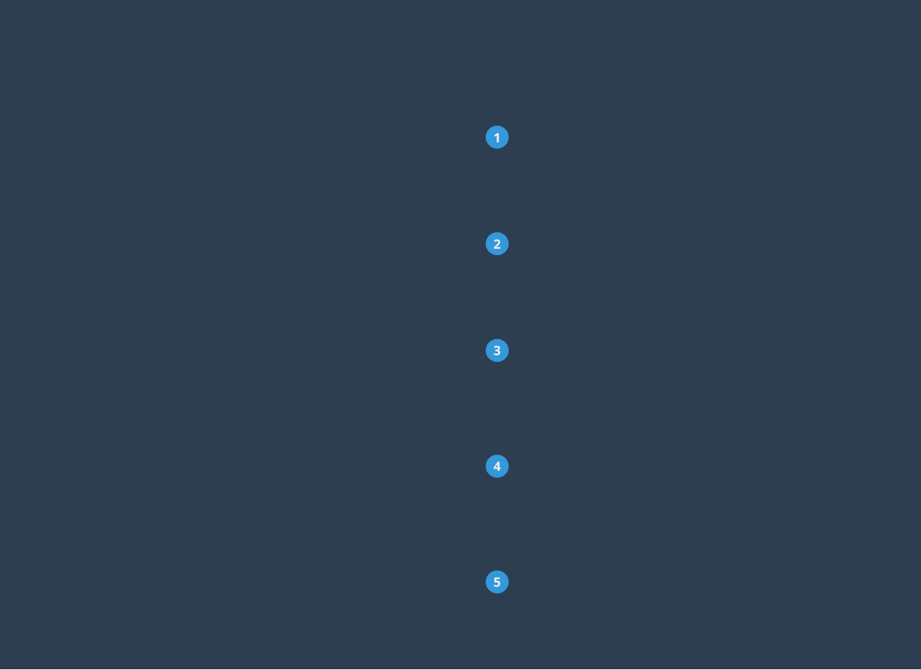
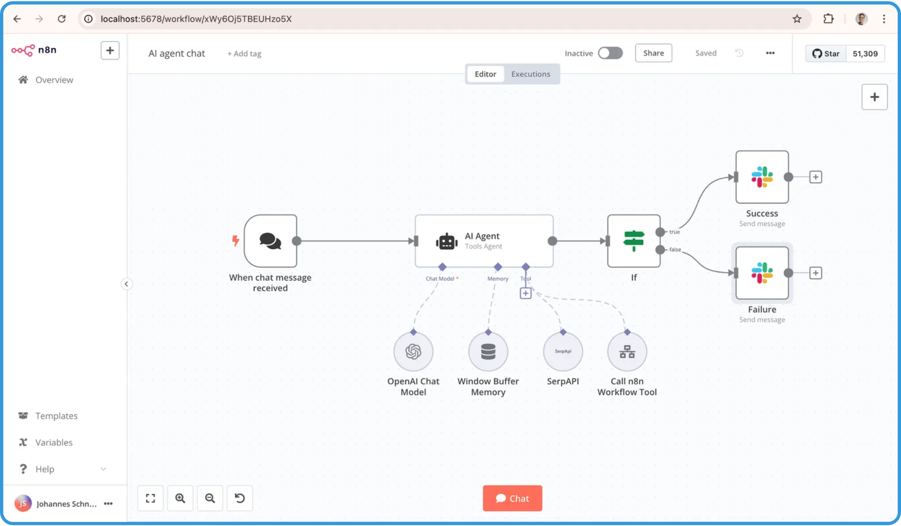
Importing the Workflow
Download Workflow File
Download the n8n workflow JSON file containing the MCP server and client configuration.
Access n8n Dashboard
Open your n8n instance in a web browser and navigate to the Workflows tab.
Import JSON Workflow
Click the "New" button, then select "Import from JSON" and upload the downloaded workflow file.
Important Note:
After importing the workflow, ensure all credentials are properly configured before activating. The workflow will not function correctly without valid API keys for Google Gemini and Firecrawl (if used).
Configure Credentials
Locate the Google Gemini Chat Model and MCP Client nodes, then update the API keys in their respective credential sections.
Activate the Workflow
Toggle the "Active" switch in the top right corner of the workflow editor to enable the MCP system.

Slide 6

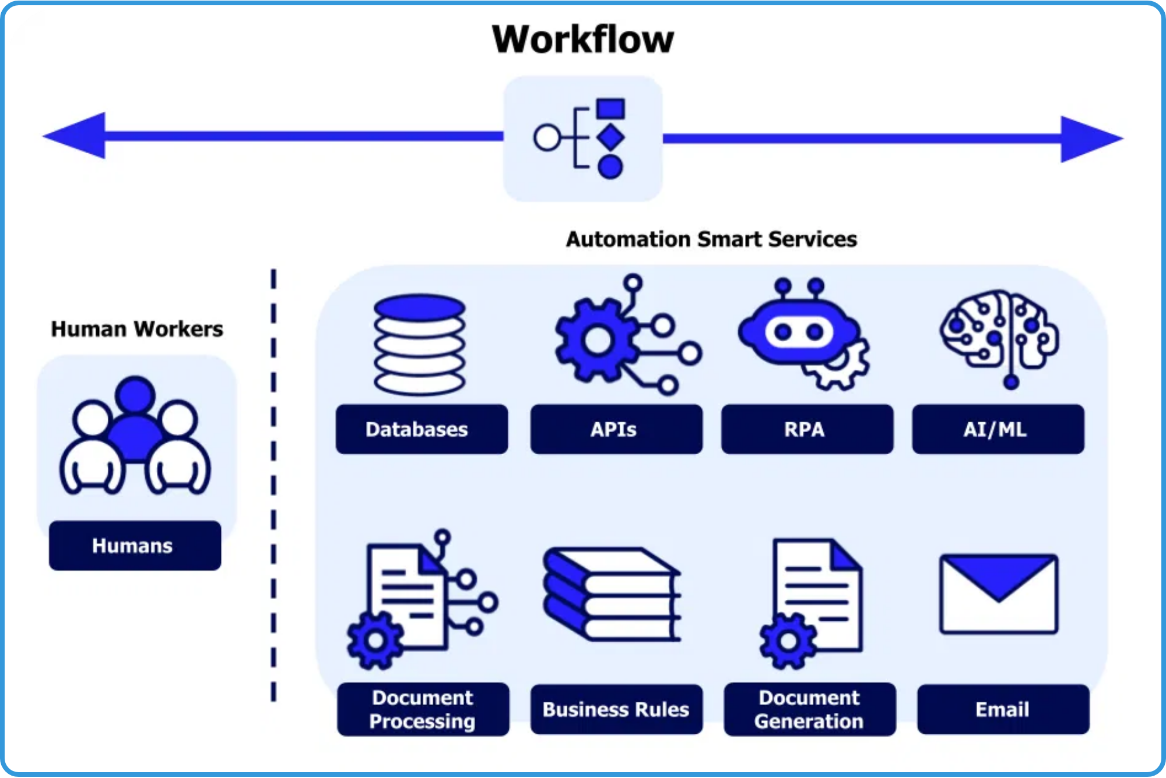

Basic Usage
1
Send a Message to the Webhook
Send a message to the configured webhook URL of your n8n workflow to initiate the conversation.
2
AI Processing
The workflow processes your message through the AI Agent and Google Gemini Chat Model, maintaining context with Simple Memory.
3
Data Enrichment (Optional)
If needed, the MCP Client uses Firecrawl to gather additional information to enhance the AI's response.
4
Receive AI Response
The system returns a contextually relevant response based on your query and any additional data gathered.
No Login Required
This implementation is designed to work without requiring user login, making it easy to integrate into various applications.

Slide 7



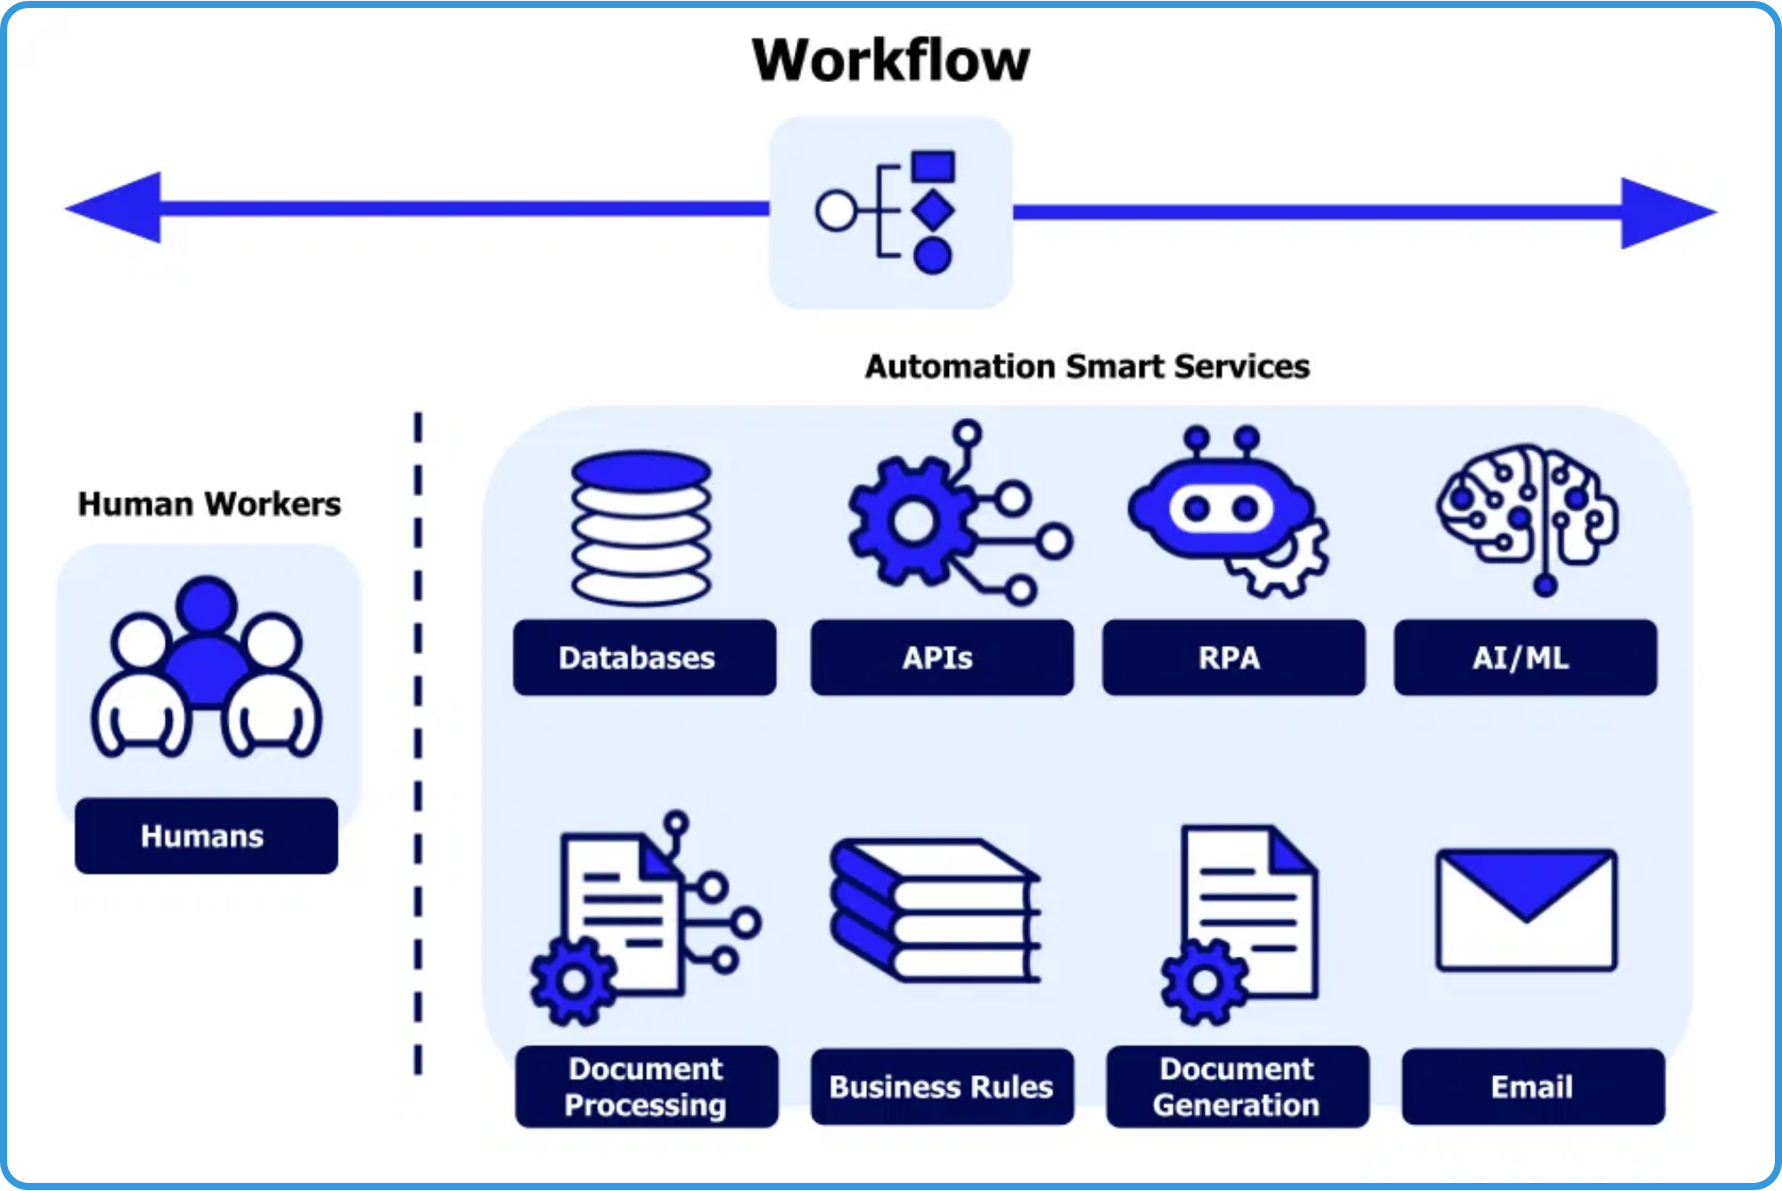


Advanced Usage
Customizing AI Behavior
Modify the Google Gemini Chat Model parameters to adjust response style, creativity, and focus areas
Adding External Integrations
Connect additional data sources or services by
extending the n8n workflow with new nodes
Examples:
Weather APIs, News feeds, Database connections
Enhancing Memory Systems
Implement advanced context management by customizing the Simple Memory node or adding vector databases
Implementing Access Controls
Add authentication and authorization layers to restrict access to specific users or groups

Slide 8

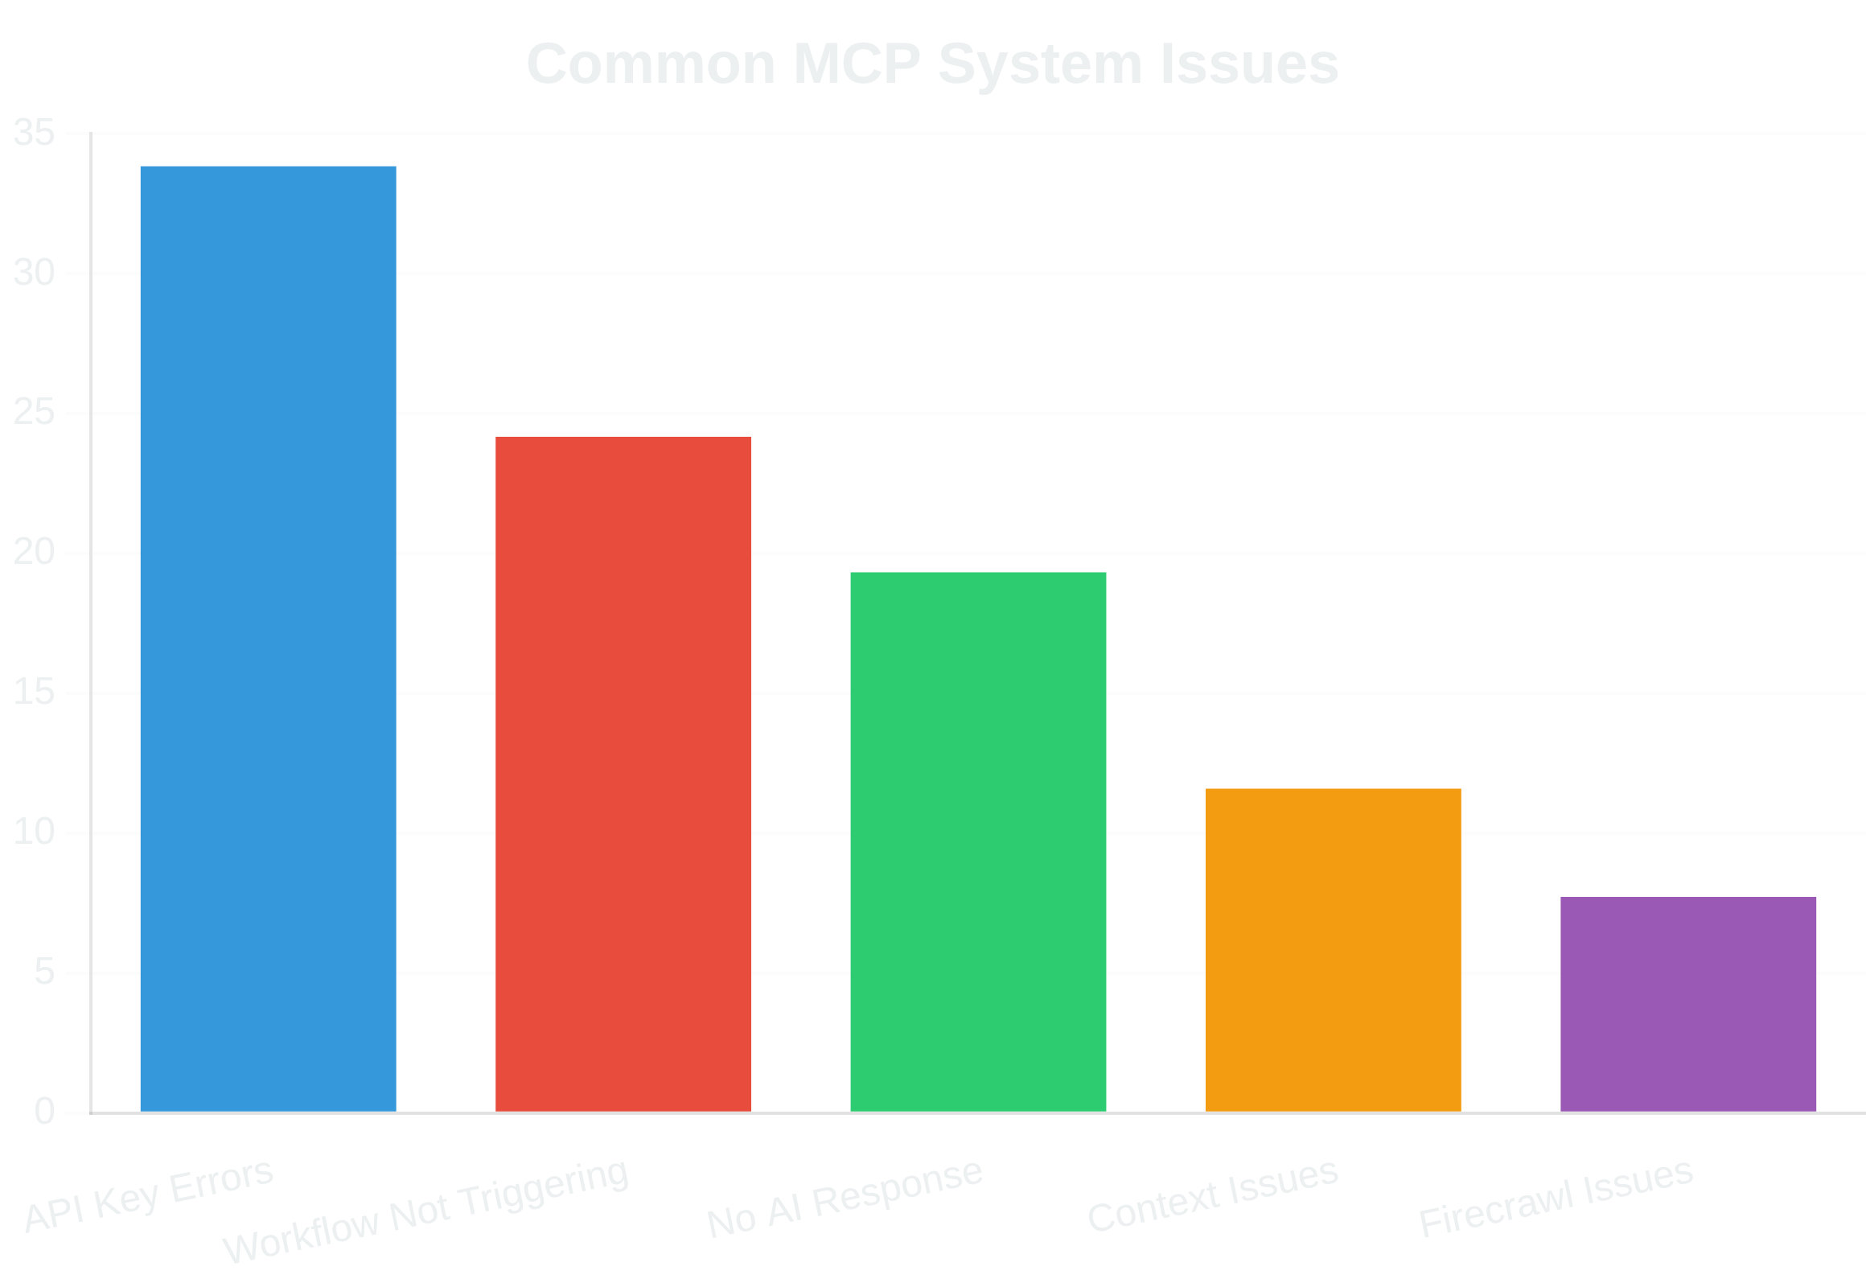





Troubleshooting
No Response from AI
Verify that the Google Gemini Chat Model node is correctly configured and that you have sufficient API quotas.
Firecrawl Issues
Check your Firecrawl API key and ensure the target URLs are accessible. Verify that the scraping rules are correctly defined.
Workflow Not Triggering
Ensure the workflow is active in n8n and verify the webhook URL is correct. Check that your messages are being sent to the correct endpoint.
Context Not Maintained
Review the 'Simple Memory' node configuration to ensure it's properly storing and retrieving conversational context.
API Key Errors
Double-check that your Google Gemini and Firecrawl API keys are correctly entered in the respective nodes' credentials.

Slide 9




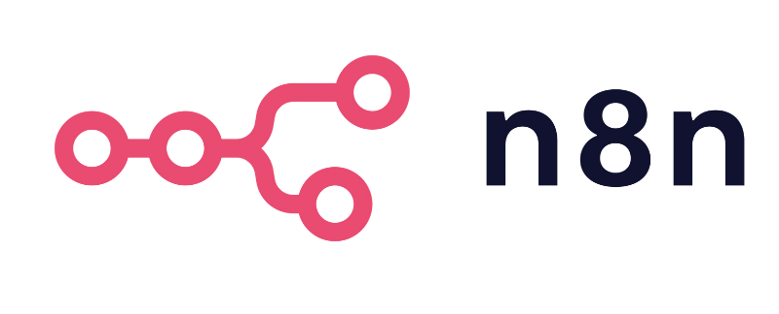
Conclusion
The
MCP Server and Client
system built with
n8n and Firecrawl
provides a
powerful, flexible framework for creating AI-powered conversational
applications. With its modular design and no-login requirement, it can be easily
integrated into various systems and customized for different use cases.
Customer Support
Research Assistant
Process Automation
Implement intelligent chatbots that can handle customer inquiries with context awareness
Create AI assistants that can gather and synthesize information from multiple sources
Build intelligent agents that can automate complex workflows with natural language interfaces
Thank You!

